Slide 1
Healthcare Analytics in Action
RX 319

Slide 2
Learning Objectives
Describe how digital health can help prevent disease.
Describe the role of data in the development of the COVID-19 vaccine.
Notes:
“The Internet of Things” IoT

Slide 3
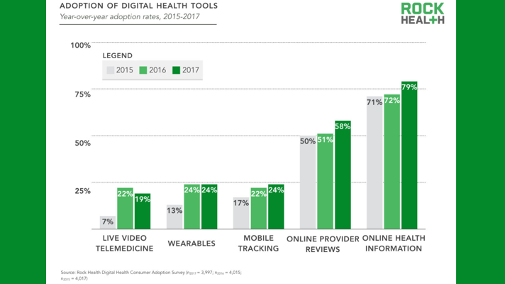

Digital Health & Risk Prediction
The Past: Annual checkup, additional appointments when necessary
Now:
Source: Comstock J, Rock Health, 2018
Notes:
“The Internet of Things” IoT

Slide 4
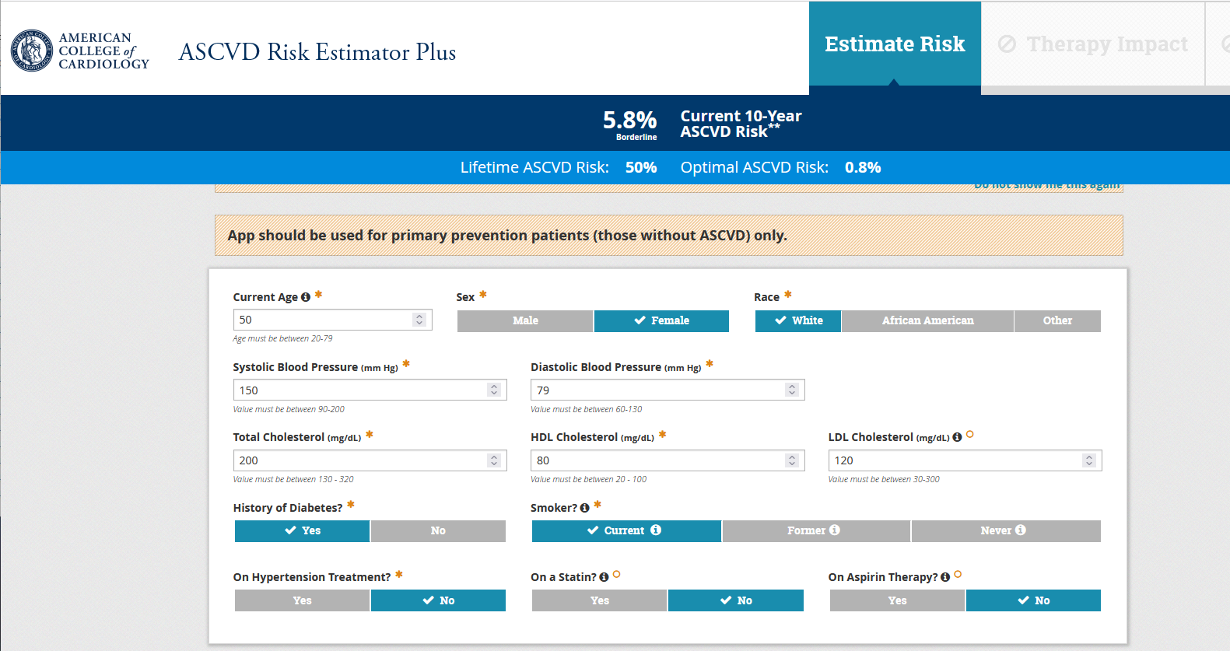
Predicting ASCVD Risk
Challenges
How to use the data?
Protecting patient privacy
Opportunity
Prevent diseases instead of treating them
4
American College of Cardiology Foundation. https://tools.acc.org/ascvd-risk-estimator-plus/#!/calculate/estimate/

Slide 5
Developing the COVID-19 Vaccine
31 Dec, 2019
Wuhan reports cluster of pneumonia cases
12 Jan, 2020
COVID-19 genetic sequence made public
30 March
Operation Warp Speed begins
14 July
Clinical trials begin
November
Strong vaccine efficacy reported
December
FDA grants EUA to Pfizer, Moderna
2021
Over 10 billion doses administered worldwide
Bioinformatics lets you figure out an entire genome in hours
Biostatistics enables fast design & completion of clinical trials
Analytics expedites the manufacture, shipping & administration
5
Sources:
https://www.biospace.com/article/a-timeline-of-covid-19-vaccine-development/
https://www.who.int/news/item/27-04-2020-who-timeline---covid-19

Slide 6
Developing the COVID-19 Vaccine
31 Dec, 2019
Wuhan reports cluster of pneumonia cases
12 Jan, 2020
COVID-19 genetic sequence made public
30 March
Operation Warp Speed begins
14 July
Clinical trials begin
November
Strong vaccine efficacy reported
December
FDA grants EUA to Pfizer, Moderna
2021
Over 9 billion doses administered worldwide
COVID data dashboards everywhere!
Bioinformatics lets you figure out an entire genome in hours
Biostatistics enables fast design & completion of clinical trials
Analytics expedites the manufacture, shipping & administration
6
Sources:
https://www.biospace.com/article/a-timeline-of-covid-19-vaccine-development/
https://www.who.int/news/item/27-04-2020-who-timeline---covid-19

